Slide 1
Breast Cancer Risk Prediction
S J Harshavardhan
Date : 08-02-2025

Slide 2
Dataset Overview
This project aims to analyze breast cancer patient survival rates and estimate their likelihood of surviving over the next 10 years.
Understand Survival Patterns:
Leverage advanced statistical methods and machine learning to analyze breast cancer survival trends and forecast 10-year mortality risk.
Improve Patient Outcomes:
Utilize analytical insights to refine treatment strategies and deliver accurate prognosis information, enabling more personalized and effective patient care.

Slide 3
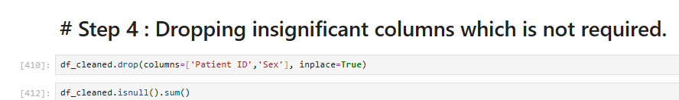
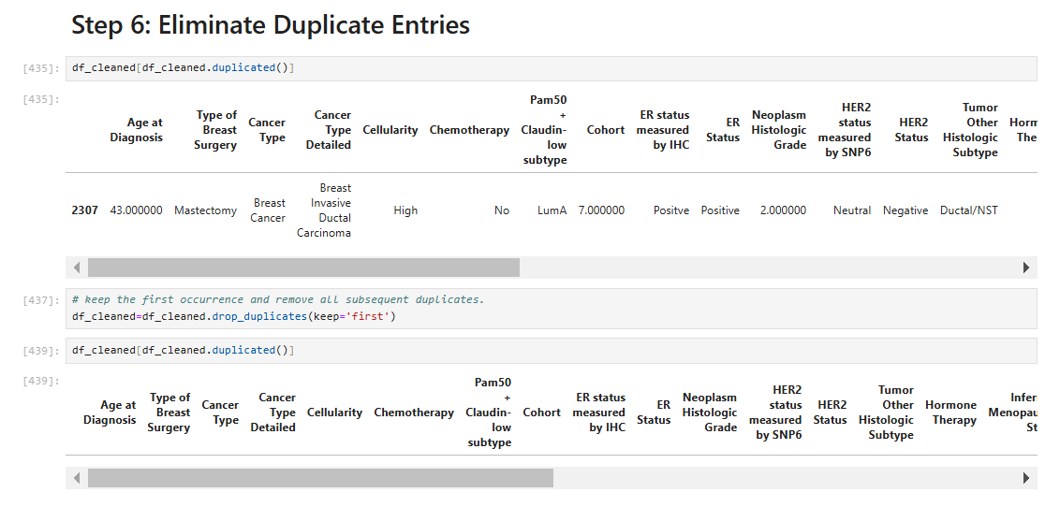
Data Cleaning & Transformation
Dataset Dimensions:
Total Records: 2,012 (rows)
Total Features: 34 (columns)
Data Cleaning Steps:
Eliminated Irrelevant Columns:
Removed the Patient ID and Sex columns as they were not relevant to the analysis.
Handled Duplicates:
Identified and removed one duplicate entry, retaining only the first occurrence of each record.

Slide 4
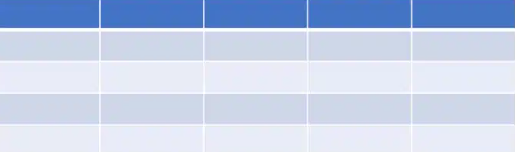

Treating Missing Data
Removing Rows: Rows containing missing values in key columns (such as Relapse Free Status, ER Status measured by IHC, ER Status, Age at Diagnosis, and Cohort) were excluded, as they represented less than 4% of the total dataset. This step preserves the integrity of the data while minimizing the loss of information.
Replacing Missing Values:
Numerical Features: For columns with more than 4% missing values, I applied median imputation. The median is less sensitive to outliers, offering a stable and representative value for filling in the missing data.
Categorical Features: For categorical columns, missing values were replaced with the mode (the most frequent value), ensuring that the most common category is preserved and maintaining the overall data distribution.

Slide 5
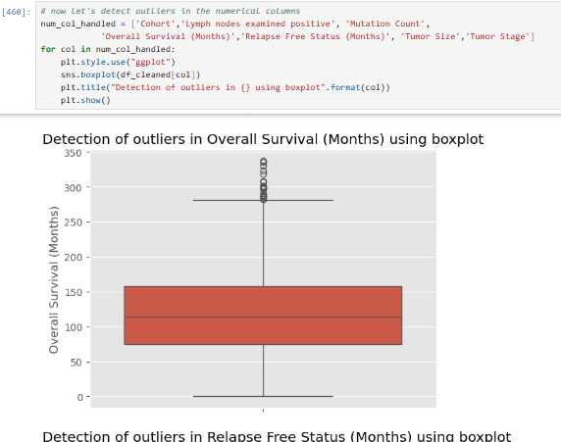
Exploratory Data Analysis (EDA):
Outlier Handling: Addressing outliers is essential for improving model performance. By evaluating both logarithmic transformation and capping techniques, I was able to determine the most effective method for this dataset, resulting in more accurate and consistent predictions.
Exploring the data through visualizations and summary statistics helps uncover insights and identify underlying patterns.
Data-Type Conversion: Converting relevant variables to categorical types is a vital step to enhance the accuracy and efficiency of the EDA process, which in turn leads to better insights and model performance. For this, we changed: Tumor Stage & Neoplasm Histologic Grade.

Slide 6
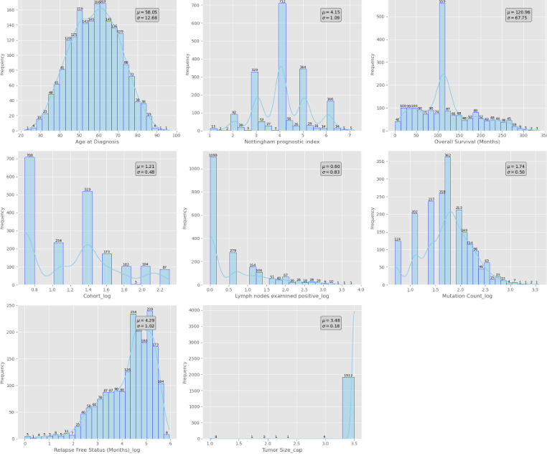
Analysis of Individual Numerical Variables
Age at Diagnosis: Most diagnoses occur between the ages of 50 and 70, which is typical for middle-aged and older women.
Nottingham Prognostic Index (NPI): Displays variability, with values clustering around the mean, suggesting a range of prognostic outcomes.
Overall Survival (Months): Shows a peak at shorter survival times, indicating a broad spectrum of survival outcomes.
Relapse Free Status (Months): Exhibits a right skew, with some patients remaining relapse-free for long durations.
Cohort: The data is tightly clustered around the mean, indicating a specific patient group.
Lymph Nodes Examined Positive: The majority show few or no positive nodes, suggesting limited metastatic spread.
Mutation Count (log): Shows a right-skewed distribution with moderate to high mutation counts, potentially signaling more aggressive cancer.
Tumor Size (log): Appears to follow a normal distribution, reflecting the expected variation in tumor sizes.

Slide 7
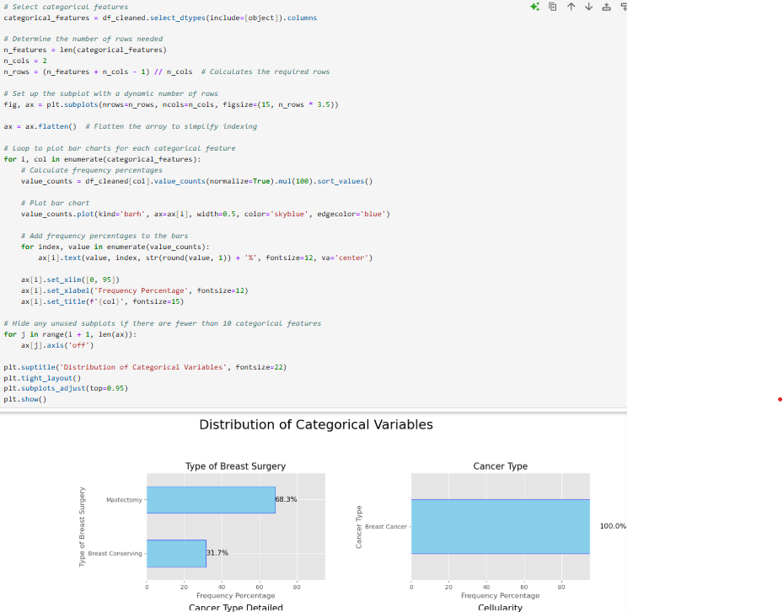
Analysis of Individual Categorical Variables
The charts offer valuable insights into several key factors influencing breast cancer patients, including surgery types, cancer classifications, and molecular subtypes (such as integrative clusters and 3-gene classifiers).
They highlight the distribution of tumor laterality, treatment approaches (chemotherapy and radiotherapy), and biomarker statuses (ER, PR, HER2).
Additional information on histologic grade, tumor stage, survival outcomes, and relapse rates provides a thorough understanding of disease progression and treatment effectiveness.
The distribution of oncotype codes may be useful in assessing recurrence risks and guiding treatment decisions.

Slide 8
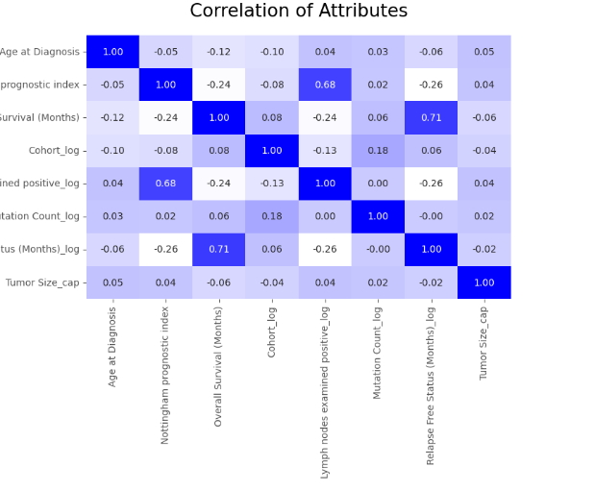
Heatmap of Correlations :
Strongest Correlation: The Nottingham Prognostic Index and Lymph Nodes Examined Positive show a strong positive correlation (0.68), reinforcing their combined prognostic value. Update the slide to highlight this as a key insight.
Moderate Correlation Between Survival Metrics: Overall Survival (Months) and Relapse-Free Status (Months) have a moderate correlation (0.71), indicating a relationship but not a perfect dependency. Emphasize this in the analysis.
Tumor Size's Weak Influence: Tumor Size has weak correlations with all other attributes, suggesting it may have an independent role in patient prognosis. Consider updating the explanation to clarify this finding.
General Trend Observation: Most attributes have low-to-moderate correlations, indicating that multiple independent factors contribute to patient outcomes.

Slide 9
Data Preparation Steps:
DEFINING TARGET AND FEATURES:
ENCODING AND SCALING:
SPLITTING THE DATASET:
The target variable for prediction is Patient’s Vital Status.
To prevent data leakage, we exclude Overall Survival Status from the dataset.
Convert categorical columns into dummy variables for proper model interpretation.
Normalize numerical features to ensure consistency in model training.
The data is split into 80% training and 20% testing sets.
The dataset is separated into:
X (Independent Variables): Features used for prediction.
y (Dependent Variable): The target outcome we aim to predict.

Slide 10
Machine Learning Models - Overview
Model Training & Evaluation:
Implemented a Classic Model Function to train, evaluate, and visualize model performance.
Used stratified 5-fold cross-validation to ensure reliable performance metrics.
Data Preprocessing:
Feature Scaling: Standardized numerical features for consistent model training.
Encoding: Converted categorical target variables for better compatibility.
Performance Assessment:
Cross-validation scores evaluate model stability across different data splits.
ROC-AUC score measures the model’s ability to distinguish between classes.
Model Performance Visualization:
Confusion Matrix & ROC Curve: Graphical representation of predictions and classification performance.
Classification Report: Provides key metrics like Precision, Recall, and F1-score for each class.
Models Applied: SVM | Logistic Regression | Random Forest | Decision Tree | XGBoost

Slide 11
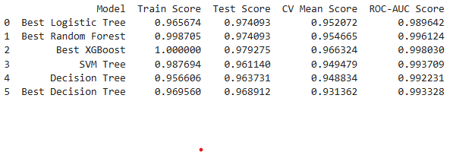
Model Performance Comparison
Top Performing Model: XGBoost
Achieved the highest Test Accuracy (0.979) and ROC-AUC Score (0.998).
Demonstrates exceptional performance in both prediction accuracy and class separation.
Training Performance Insights:
XGBoost & Random Forest exhibited the highest training scores.
Indicates a strong model fit on the training dataset.
Conclusion:
XGBoost emerges as the most effective model due to its optimal balance of high accuracy and ROC-AUC Score.
Best suited for breast cancer survival prediction in this analysis.

Slide 12
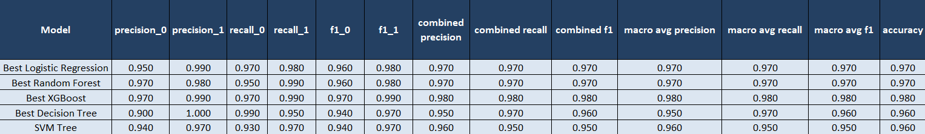
Key Findings & Insights

Slide 13
Model Evaluation & Key Takeaways
Takeaways
🏆 Best XGBoost: The Top Performer
✔ Highest Accuracy (0.980), Combined Precision (0.980), and Combined Recall (0.980) – indicating exceptional predictive capability. ✔ Maintains a balanced performance across all key metrics, ensuring both sensitivity (recall) and specificity (precision) are optimized.
🌟 Best Random Forest: A Strong Contender
✔ Delivers high precision, recall, and F1-score across all classes. ✔ Performance is comparable to XGBoost, but slightly lower in macro average metrics.
📊 Best Logistic Regression: Reliable & Consistent
✔ Exhibits high accuracy and precision, making it a dependable model. ✔ Slightly lower combined F1-score compared to XGBoost and Random Forest.
🔍 Conclusion: Why XGBoost Stands Out?
✅ XGBoost is the recommended model due to its superior balance between accuracy, precision, recall, and F1-score. ✅ It provides the best trade-off between sensitivity (recall) and specificity (precision), ensuring robust and reliable predictions. ✅ Ideal for breast cancer survival prediction, maximizing both interpretability and predictive power.

Slide 14
Limitations & Future Directions
🔍 Limitations
1️⃣ Data Constraints – The study is based on a single dataset, which may limit generalizability and fail to represent diverse patient populations or rare cases. 2️⃣ Feature Availability – The analysis is restricted to the provided features, potentially excluding critical genetic or environmental factors that influence breast cancer survival. 3️⃣ Model Interpretability – While models like XGBoost offer high predictive accuracy, their complexity makes it challenging to interpret the decision-making process.
🚀 Future Improvements
✅ Model Refinement – Enhance predictive power through hyperparameter tuning, ensemble techniques, and deep learning approaches. ✅ Feature Expansion – Integrate additional clinical, genetic, and environmental factors to provide deeper insights and improve model reliability. ✅ Real-World Validation – Test model predictions in clinical settings, working alongside healthcare professionals to ensure practical applicability and integration.

Slide 15

Questions ?

Slide 16
Thank You!

